Slide 1
Lord Farquaad’s Star Squad
Sentiment Analysis Web App

Slide 2
data
Kaggle sentiment analysis data
Attributes
tweet id
entity (topic of tweet)
sentiment (desired feature)
text (desired feature)

Slide 3
exploratory data analysis
74,682 records
20,832 positive
22,542 negative
Example
Perfect Casting for first Lilith, most anticipated film - Positive
I’m getting on borderlands and i’m going to kill you - Negative

Slide 4
preprocessing
Only use positive and negative records for sentiment
Convert all text to lowercase
Remove retweets from text
Lemmatize
Convert variations of words into their base format
Ex. Running -> run, ran -> run
Remove stopwords
Removes common words with no context
Ex. a, an, the, me, my, myself, should, what, this, that, etc
Tokenize
Pad sequences
Final result: 22.5k Positive, 20.8k Negative tweets
Notes:
You start here

Slide 5
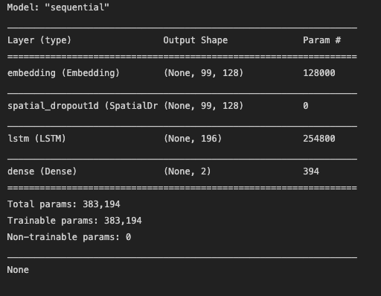
model
LSTM model
Long short-term memory
Recurrent Neural Network
Distinguish context by using previous words in sentence
Model finds differences between the positive and negative samples
Final dense layer with a shape of 2 (positive/negative) and uses a softmax activation function
Softmax is ideal when loss function is categorical cross entropy since tweet can only belong in one category

Slide 6
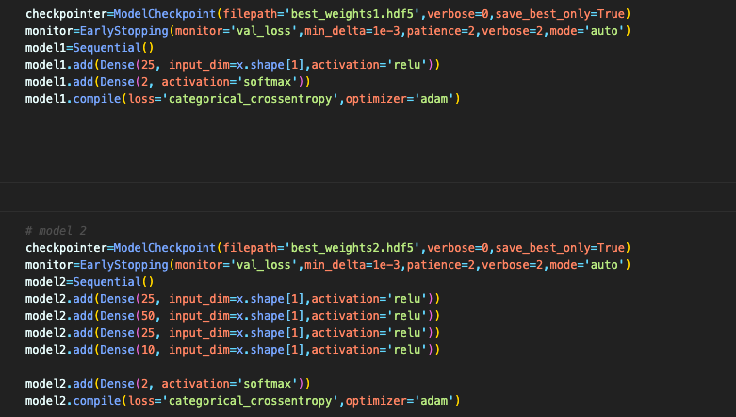
model
Neural network 1 / 2
Notes:
Austin

Slide 7

model
Logistic Regression
Notes:
Austin

Slide 8
performance
LSTM
Positive accuracy 90%
Negative accuracy 84%
NN 1
F1 score = 89%, recall 91%, precision 87%
NN 2
F1 score = 92%, recall 89%, precision 93%
Logistic Regression
F1 score 87%
Notes:
Austin

Slide 9
deployment
Amazon Web Services
Elastic Beanstalk
Codepipeline
Python
Flask
Twitter API?
Demo
http://twitsenti-env.eba-d3m46afb.us-west-2.elasticbeanstalk.com/
Notes:
Paul

